Slide 1
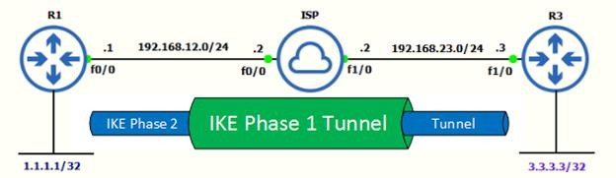
Site to Site IPSec VPN Tunnel in Cisco IOS Routers:
Step 1. Configuring IPSec Phase 1 (ISAKMP Policy)
R1(config)#crypto isakmp policy 5
R1(config-isakmp)#authentication pre-share
R1(config-isakmp)#encryption 3des
R1(config-isakmp)#group 2
R1(config-isakmp)#hash sha
R1(config-isakmp)#lifetime 86400
R1(config-isakmp)#exit
R1(config)#crypto isakmp key cisco123 address 192.168.23.3
crypto isakmp policy 5 | Creates ISAKMP policy number 5. Can create multiple policies, for example 7, 8, 9 with different configuration. Router will check list of policies one by one, if any matched, IPSec negotiation move to Phase 2
authentication pre-share | Authentication method is pre-shared key.
encryption 3DES | 3DES encryption algorithm will be used for Phase 1.
group 2 | Diffie-Hellman group to be used is group 2.
hash sha | SHA algorithm will be used.
lifetime 86400 | Phase 1 lifetime is 86400 seconds which is 1 day.
crypto isakmp key cisco123 address 192.168.23.3 | The Phase 1 password is cisco123 and remote peer IP address is 192.168.23.3.

Slide 2
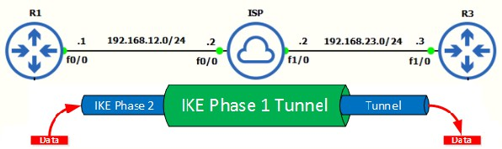
Step 2. Configuring IPSec Phase 2 (Transform Set):
R1(config)#crypto ipsec transform-set TSET esp-aes 128 esp-md5-hmac
R1(cfg-crypto-trans)#crypto ipsec security-association lifetime seconds 3600
crypto ipsec transform-set TSET | Creates transform-set called TSET
esp-aes | AES 128-bit encryption method and ESP IPSec protocol will be used.
esp-md5-hmac | MD5 hashing algorithm will be used.
crypto ipsec security-association lifetime seconds 3600 | This is the amount to time that the phase 2 session exists before re-negotiation.
Step 3. Configuring ACL for Interesting Traffic.
ACL defines interesting traffic that needs to go through the VPN tunnel. Traffic originating from
1.1.1.1 host to 3.3.3.3 host will go via VPN tunnel.
R1(config)#ip access-list extended VPN-TRAFFIC
R1(config-ext-nacl)# permit ip host 1.1.1.1 host 3.3.3.3
Step 4. Configure Crypto Map.
Crypto Map ties together & connect above defined ISAKMP and IPSec configuration together.
R1(config)#crypto map CMAP 10 ipsec-isakmp
R1(config-crypto-map)#match address VPN-TRAFFIC
R1(config-crypto-map)#set peer 192.168.23.3
R1(config-crypto-map)#set transform-set TSET
crypto map CMAP 10 ipsec-isakmp | Creates new crypto map with sequence number 10. Can create more sequence numbers with same crypto map name if you have multiple sites.
match address VPN- TRAFFIC | Its matches interesting traffic from ACL named VPN-TRAFFIC.
set peer 192.168.23.3 | This is public IP address of R3.
set transform-set TSET | This links the transform-set in this crypto map configuration.

Slide 3
Step 5. Apply Crypto Map to Outgoing Interface of R1.
The final step is to apply the crypto map to the outgoing interface of the router. Here, the outgoing interface is FastEthernet 0/0. You can have multiple crypto maps defined in the configuration of a router, but you can only have one applied to an interface at once time. If you have a router that needs to connect to multiple peers from the same interface, the peers will need to be defined in the single crypto map. You would can another numbered entry to the crypto map with different transform-sets and match ACLs. Site 1 configuration is Completed.
R1(config)#int fa0/0
R1(config-if)#crypto map CMAP
Site-2, Router 3 Configuration:
Move to the Site-2 Router to complete the VPN configuration. The settings for Router 3 are identical, with the only difference being the peer IP Addresses and Access Lists:
Step 1. Configuring IPSec Phase 1 (ISAKMP Policy)
R3(config)#crypto isakmp policy 5
R3(config-isakmp)#authentication pre-share
R3(config-isakmp)#encryption 3des
R3(config-isakmp)#group 2
R3(config-isakmp)#hash sha
R3(config-isakmp)#lifetime 86400
R3(config-isakmp)#exit
R3(config)#crypto isakmp key cisco123 address 192.168.12.1
Step 2. Configuring IPSec Phase 2 (Transform Set):
R3(config)#crypto ipsec transform-set TSET esp-aes 128 esp-md5-hmac
R3(cfg-crypto-trans)#crypto ipsec security-association lifetime seconds 3600
Step 3. Configuring ACL for Interesting Traffic.
R3(config)#ip access-list extended VPN-TRAFFIC R3(config-ext-nacl)# permit ip host 3.3.3.3 host 1.1.1.1
Step 4. Configure Crypto Map.
R3(config)#crypto map CMAP 10 ipsec-isakmp
R3(config-crypto-map)#match address VPN-TRAFFIC
R3(config-crypto-map)#set peer 192.168.12.1
R3(config-crypto-map)#set transform-set TSET
Step 5. Apply Crypto Map to outgoing interface of R1.
R3(config)#int fa1/0
R3(config-if)#crypto map CMAP
Note: Red color need to change in R3 router.

Slide 4
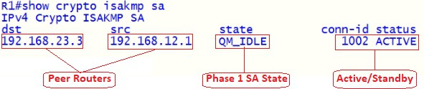
Verification and Testing.
To test the VPN connection let’s ping from R1 to R3 loopback interface.
Verify IPSec Phase 1 Connection
Commands | Description
R1#ping 3.3.3.3 source loopback 1 | Ping from R1 to R3 Loopback Interface
R1# show crypto isakmp key | Display Phase 1 Key
R1# show crypto isakmp peers | Display Phase 1 peer
R1# show crypto isakmp policy | Display Phase 1 policy Details
R1# show crypto isakmp sa | Verify the IPSec Phase 1 Connection
R1# show crypto session | Verify Active Session Phase1 & Phase 2
Verify IPSec Phase 2 Connection
Commands | Description
R1# show crypto ipsec sa | Verify IPSec Phase 2 connection
R1# show crypto ipsec transform-set | Display Phase 2 transform Set
R1# show crypto ipsec security-association | Display Phase 2 Life time
R1# show crypto ipsec spi-lookup | Display Active SPI table
State | Description
MM_NO_STATE | ISAKMP SA process has started but has not continued to form.
MM_SA_SETUP | Both peers agree on ISAKMP SA parameters & move along process.
MM_KEY_EXCH | This state could mean there is a mis-matched authentication type or PSK, if it does not proceed to the next step
MM_KEY_AUTH | ISAKMP SA’s have been authenticated in main mode and will proceed to QM_IDLE immediately.
AG_NO_STATE | ISAKMP SA process has started but has not continued to form (typically do to a connectivity issue with the peer).
AG_INIT_EXCH | Peers have exchanged their first set of packets in aggressive mode but have not authenticated yet.
AG_AUTH | ISAKMP SA’s have been authenticated in aggressive mode and will proceed to QM_IDLE immediately.
QM_IDLE | The ISAKMP SA is idle and authenticated, After Phase 1 successful.

Slide 5
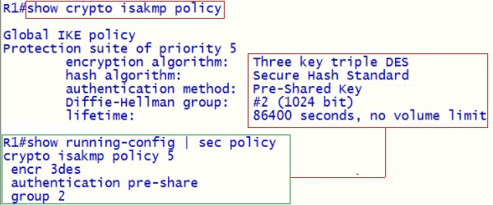
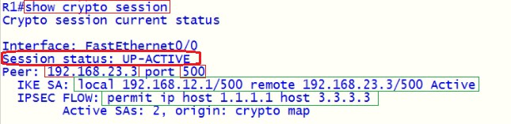
This command provides information on both Phase 1 and Phase 2. This command provides output for the interface that’s being used; it will identify whether the session is up and active. This command will also identify the peer information.
Status | Description
Up-Active | IPSec SA is up/active and transferring data.
Up-IDLE | IPSec SA is up, but there is not data going over the tunnel.
Up-No-IKE | This occurs when one end of the VPN tunnel terminates the IPSec VPN and the remote end attempts to keep using.
Down-Negotiating | The tunnel is down but still negotiating parameters to complete tunnel.
Down | The VPN tunnel is down.
show crypto ipsec sa – This output displays much information, such as the #pkts encaps/encrypt/decap/decrypt, these numbers tell us how many packets have actually crossed the IPSec tunnel and also verifies we are receiving traffic back from the remote end of the VPN tunnel. This will also tell us the local and remote SPI, transform-set, DH group, & the tunnel mode for IPSec SA.

Slide 6
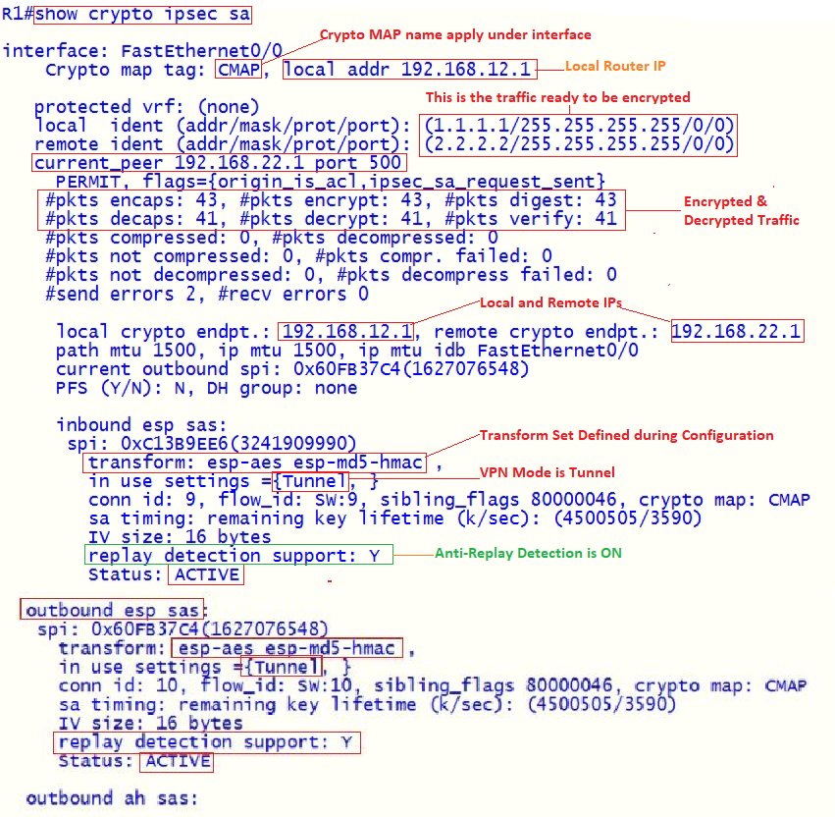
On FEthernet0/0, the crypto map named CMAP is enabled.
The IP address uses for IPSec communications is 192.168.12.1.
The local and remote ident lines display the peers involved in the connection.
If the connection successfully set up, will see number of packets encapsulated & encrypted.
These are the local & remote endpoints for the IPSec connection, as well as the MTU used.
Inbound is from remote peer to this router. Outbound is from this router to remote peer.
For both inbound and outbound, there are two sections: one for ESP and one for AH.
There is nothing listed under AH, indicating that AH is not used to protect the connection.

